Slide 1
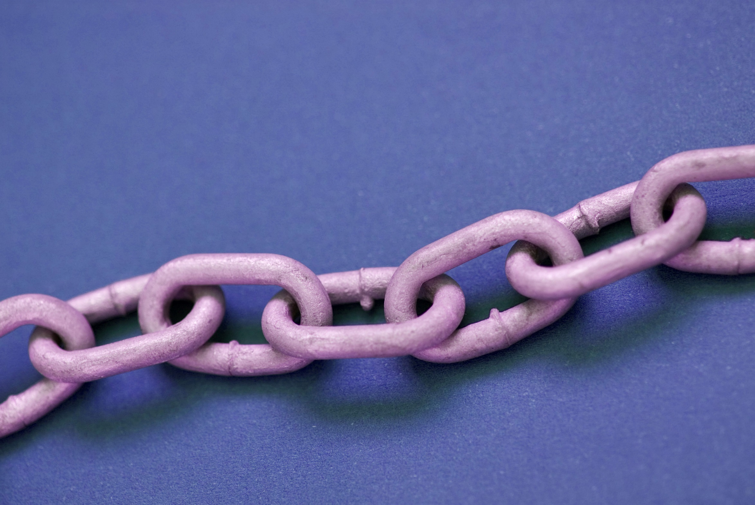
Building connections: Using analogies and metaphors in information literacy instruction
Kathy Snediker
Reference & Instruction Librarian
University of South Carolina
Image by stockarch - stockarch.com
Notes:
Thanks for joining me today! I’m Kathy Snediker, and I’m a Reference & Instruction Librarian at USC Columbia.
Been there 4. 5 years
Teaching includes a variety of one-shots – including intro level classes like ENGL 102 and UNIV 101, and also upper-level undergrad courses, mostly in history and geography.
We also have a for-credit LIBR 101 course that is now primarily delivered online, but I have had the chance to teach my own face-to-face section 3 times now.
Most recently I taught this past Spring semester, and I was trying to make some of my lessons a bit more fresh and engaging.
As I started developing new activities, I found those that worked the best often included some kind of analogy or metaphor, and so now I purposefully look for ways to help make connections for my students.
So today I’d like to share with you some effective and hopefully fun ways to incorporate analogies. I don’t want anyone having flashbacks to standardized tests, so when I’m talking about analogies…

Slide 2
PROSAIC :: MUNDANE
A. obdurate : foolish
B. ascetic : austere
C. clamorous : captive
D. loquacious : taciturn
E. peremptory : spontaneous
Notes:
…I’m thinking less of this…

Slide 3
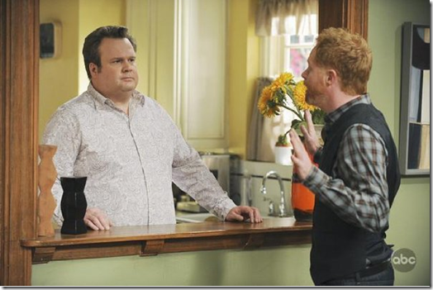
Cameron: "In this relationship, I'm the gas pedal and you're the brakes." Mitchell: "OK, wait, wait, wait. Last week, you said that you were the painting and I was the frame." Cameron: "That's if we were artwork. This is if we were a car.“
Mitchell: "I know what part you'd be if we were a horse."
Notes:
…And more of this.
[Read to audience if necessary]
So I haven’t figured out a way to incorporate this into info lit yet, but…[next slide]

Slide 4
Why analogies work
Benefits in instruction
Qualities of good analogies
“A plus” by Ludwig at https://flic.kr/p/ecYqYi under CC: by-nc-nd/2.0
Notes:
…This demonstrates that analogies and metaphors are a common way that people think and process information in everyday life.
This room is like a refrigerator!
The mall was a zoo today!
She is on an emotional rollercoaster.
*Why analogies work
To quote from Figures of thought for college writers:
“All of us have learned new or abstract concepts by thinking about them in terms of more familiar, concrete objects. Seeing resemblances through analogy is how we connect new and old information so that we can increase our knowledge and build coherence among our experiences and ideas.”
They…
Connect the familiar with the unfamiliar
Provide a structure for assimilating new information
*Benefits in instruction
Better comprehension
Increased recall and retention of information
Decreased student anxiety
*Qualities of good analogies
Familiarity - Need to pick something familiar to students with the intention of activating prior knowledge
Relevance - Even better is not just familiar but relevant to students and their lives – you’ll see in my examples I use things like dating, TV, Twitter, finding an apartment.
Best examples use vivid imagery or humor to make them memorable - “Canada is like a loft apartment over a really great party…” – Robin Williams
At least one aspect of the relationship should be concrete or situational as opposed to an abstract concept, idea, or feeling (ex. Love, freedom, justice, etc.) which can be more subjective and open to each person’s interpretation

Slide 5
Best practices: constructing and presenting¹
Identify salient attributes
Match with prior knowledge (audience)
Describe the similarities
Identify any limitations
Develop analogy in verbal and/or visual form
Present comparison early in the instruction
Use it to explain examples (and non-examples)
Have learners practice and refer back
1. Adapted from Davis, P. M., & Davidson, G. V. (1994). Language is like the human body: Teaching concepts through analogy. Educational Technology, 34, 27–32.
Notes:
1. Identify salient attributes that promote understanding of the concept
2. Match the concept with something from the learner’s prior knowledge or experience – attributes need to be similar
3. When describing the similarities, be thorough and clear – don’t expect students to make the connections themselves
4. Be clear about any boundaries or limitations to the analogy
5. Develop the analogy in verbal and/or visual form for presentation
6. Present it early in the instruction – gains attention, stimulates prior knowledge
7. Use it to explain examples, and also non-examples to clarify
8. Have learners practice and refer back

Slide 6
Pitfalls to avoid
First appeared 8 Dec 1961 © PEANUTS Worldwide; Accessed at http://www.peanuts.com/comicstrips/3257314
Notes:
So what can go wrong?
You’re trying to activate prior knowledge, but this can be tricky sometimes because all students’ prior knowledge is not equivalent. And some of their prior knowledge may be incomplete or inaccurate.
So a fairly obvious issue… If your analogy doesn’t refer to something familiar, you can’t activate prior knowledge.
Ex. Equating field searching online (author, title, subject) to using a card catalog isn’t going to work because many students today are not familiar with the process.
Less obvious issues in thinking about the prior knowledge of your audience:
You may be talking to international students, LGBT students, first-generation college students, etc.
Try to be sensitive to potential cultural differences or belief systems
Ex. Even something as simple as food may not be as familiar as you think
Ex. Something like getting a mortgage or other banking process, even for non-traditional students, assumes a certain economic experience that may not be as universal as you assume
Ex. Avoid things like religious examples – too many differences, and some non-religious students will not relate
Ex. Avoid heteronormative language or other assumptions about lifestyles (more details when I discuss one of the activities I have created…)
Also important…
Because of the potential for incomplete or inaccurate prior knowledge, don’t assume students will see the connections/relationship automatically – be thorough and clear in stating the common attributes so that you can correct any misconceptions
Ex. Time Warner Cable is to the History Channel what EBSCO is to Academic Search Complete
Discuss explicitly that one is a commercial company that is paid to provide a service and the other is one of many products that company provides to you, and those products give you specific content. Shows on the History Channel won’t be the same as shows on other channels, just like articles in ASC won’t be the same as in PsycInfo.

Slide 7
Examples for information literacy:
Basic analogies
Hashtags/Subject terms
Cable company/Database vendor
Activities
“Apartment hunting” (Analyzing authority)
“Jury selection” (Identifying bias)
“Finding your perfect match” (Boolean operators)
“What do we have in common?” (Research process)
Notes:
Questions about the two examples I’ve already discussed?
I use these often in one-shot sessions whenever I’m explaining either of these concepts.
Now I want go through a few activities I have used in both for-credit and one-shot sessions.

Slide 8
Evaluating Authority Situation #1
You have to move and are considering renting an apartment in a local complex. If you could only ask one of these people for information, who would it be?
a. Your friend who lived there three years ago
b. Someone you don’t know who lives there now
c. A leasing agent for the complex
Notes:
Lead students into a discussion…
Where does authority come from?
What different types of knowledge can people have?
How might an everyday scenario like this be the same as looking for authoritative sources for research?
How might it be different?

Slide 9
Identifying Bias: Jury Selection activity
30-something white woman accused of reckless driving (going 50 mph in a 30 mph zone)
Her defense is that she was rushing to pick up her children before daycare closed
She was also disrespectful and verbally abusive to the cop
Imagine you are either the prosecution or the defense lawyer. Write two questions that you want to ask prospective jurors to discover if they have potential bias for/against your side.
Notes:
Lead into a discussion with students…
What can make people biased or have a specific point of view? (personal experiences w/ family, job, etc.)
What are ways you can identify that point of view in information sources?
Persuasive or emotional appeals
Language choices
Who they represent/where money comes from

Slide 10
Finding your perfect match Imagine a new dating app…
Funny AND
Smart AND
Kind AND
Honest AND
Attractive AND
Successful AND
Volleyball player AND
Good cook AND
Good dancer AND
Outdoorsy AND
Steelers Fan

Slide 11
Finding your perfect match Imagine a new dating app…
Funny AND OR
Smart AND OR
Kind AND OR
Honest AND OR
Attractive AND OR
Successful AND OR
Volleyball player AND OR
Good cook AND OR
Good dancer AND OR
Outdoorsy AND OR
Steelers Fan

Slide 12
Finding your perfect match Imagine a new dating app…
Funny AND
Smart AND
Kind AND
Honest AND
Attractive OR
Successful OR
Volleyball player Athletic OR
Good cook OR
Good dancer
Outdoorsy
AND NOT Steelers Ravens Fan
Notes:
Think of the library catalog or the database as helping you find the “perfect” source
Don’t be so picky you don’t find anything
Don’t be so vague you just pick anything
Then practice together with a research question example and/or ask students to come up with their own search strategies

Slide 13
Icebreaker: Find 2 things in common
What does this have to do with research?
What do we have in common?
How do I try to find out?
How do I determine the right answer?
= Information need
= Research strategy
= Evaluate and synthesize info

Slide 14
Questions? Other examples?

Slide 15
Bibliography
Davis, P. M., & Davidson, G. V. (1994). Language is like the human body: Teaching concepts through analogy. Educational Technology, 34, 27–32.
Earle, R. S. (1995). Teacher imagery and metaphors: Windows to teaching and learning. Educational Technology, 35(4), 52–59.
Ford, D. G. (2002). Teaching Anecdotally. College Teaching, 50(3), 114–115. http://doi.org/10.1080/87567550209595889
Garner, R. (2005). Humor, analogy, and metaphor: H.A.M. it up in teaching. Radical Pedagogy, 6(2). Retrieved from http://www.radicalpedagogy.org
Hickey, D. J. (1999). Figures of thought for college writers. Mountain View, Calif.: Mayfield.

